Slide 1
Helpful Tip

Slide 2
Block Comment and Uncomment in VS Code
Select what you want to comment and hit “Ctrl”+”K” then “Ctrl”+”C” to comment everything selected.
“Ctrl”+”K” then “Ctrl”+”C” uncomments selected text.

Slide 3
Documentation

Slide 4
In-Line Comments
Use “#” to input lines the computer won’t read
# Calculate the area
length = 20
width = 40
area = length * width
statement = "The area is " + str(area) + "."
print(statement)

Slide 5
Function (and Class) Documentation
def Add(number1, number2):
'''
Adds the two numbers.
'''
return number1 + number2

Slide 6
Retrieving the Documentation
print(Add.__doc__)
Adds the two numbers.
That is two (2) “_”s on both sides!

Slide 7
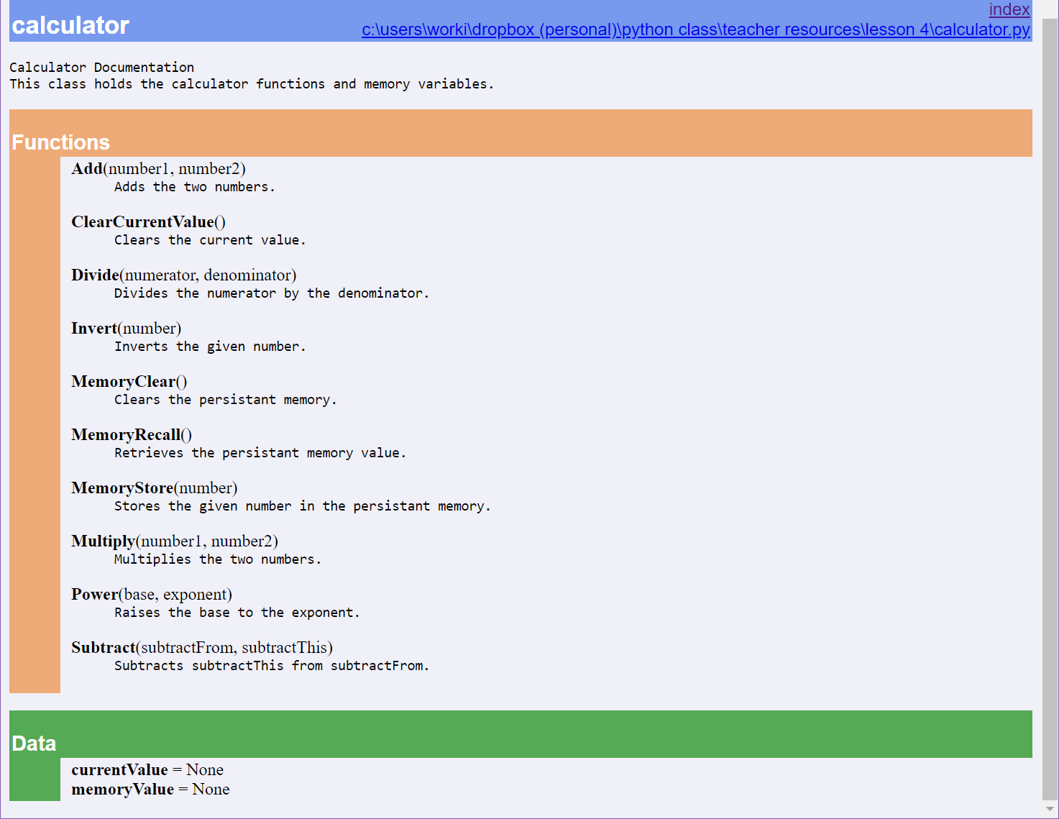
PyDoc

Slide 8
Error Handling

Slide 9
Learning Python p.1127
“In fact, realistic C programs often have as much code devoted to error detection as to doing actual work. But in Python, you don’t have to be so methodical (and neurotic!).”

Slide 10
C++
try {
// code block to try
}
catch (invalid_argument& ex) {
cout << "An invalid-argument exception occurred: " << ex.what () << endl;
}
catch (...) {
cout << "Something besides an invalid-argument exception occurred" << endl;
}
The Python Way:

Slide 11
Python
try:
print(5/0)
except ArithmeticError:
print("You had an arithmetic error.")
except:
print("You cannot do that!")
else:
print("No errors.")

Slide 12
Debugging

Slide 13
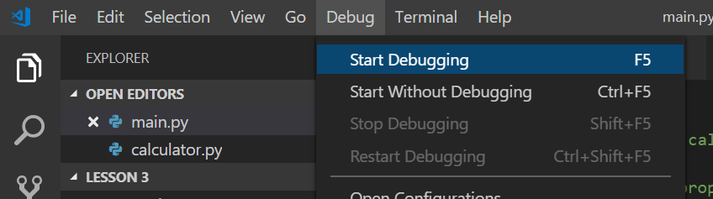
Visual Studio Code Debugger

Slide 14
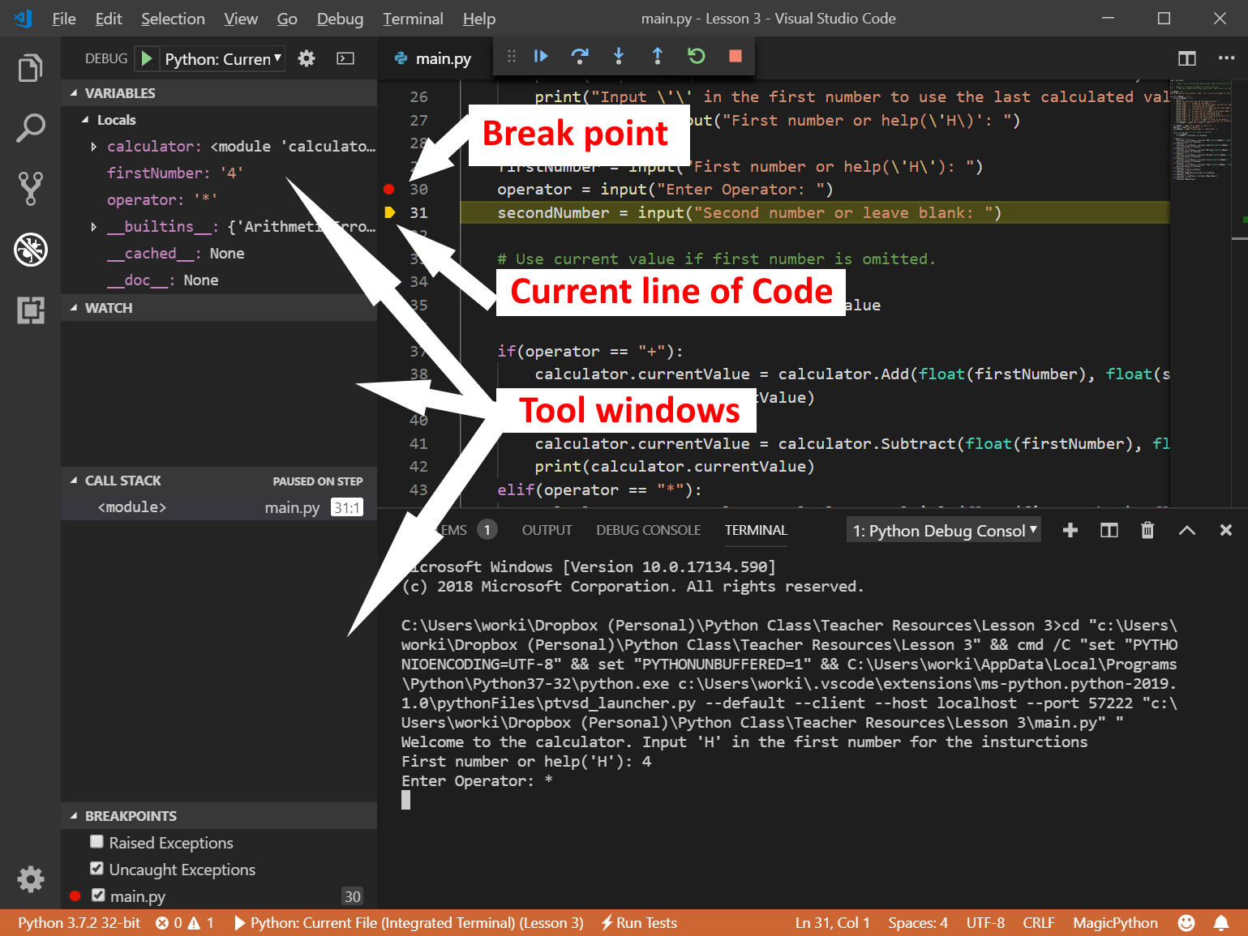

Slide 15
Unit Tests

Slide 16
unittest
import unittest
import calculator
class TestAddMethods(unittest.TestCase):
def testPositives(self):
self.assertEqual(calculator.Add(3, 6), 9)
def testNegatives(self):
self.assertEqual(calculator.Add(-3, -4), -7)
if __name__ == '__main__’:
unittest.main()

